Slide 1



PedalGo Bike-Sharing A Data-Driven Business Analysis Using SQL & Power BI
View in Power BI
Last data refresh:
3/27/2025 9:21:02 AM UTC
Downloaded at:
3/28/2025 10:25:49 AM UTC

Slide 2
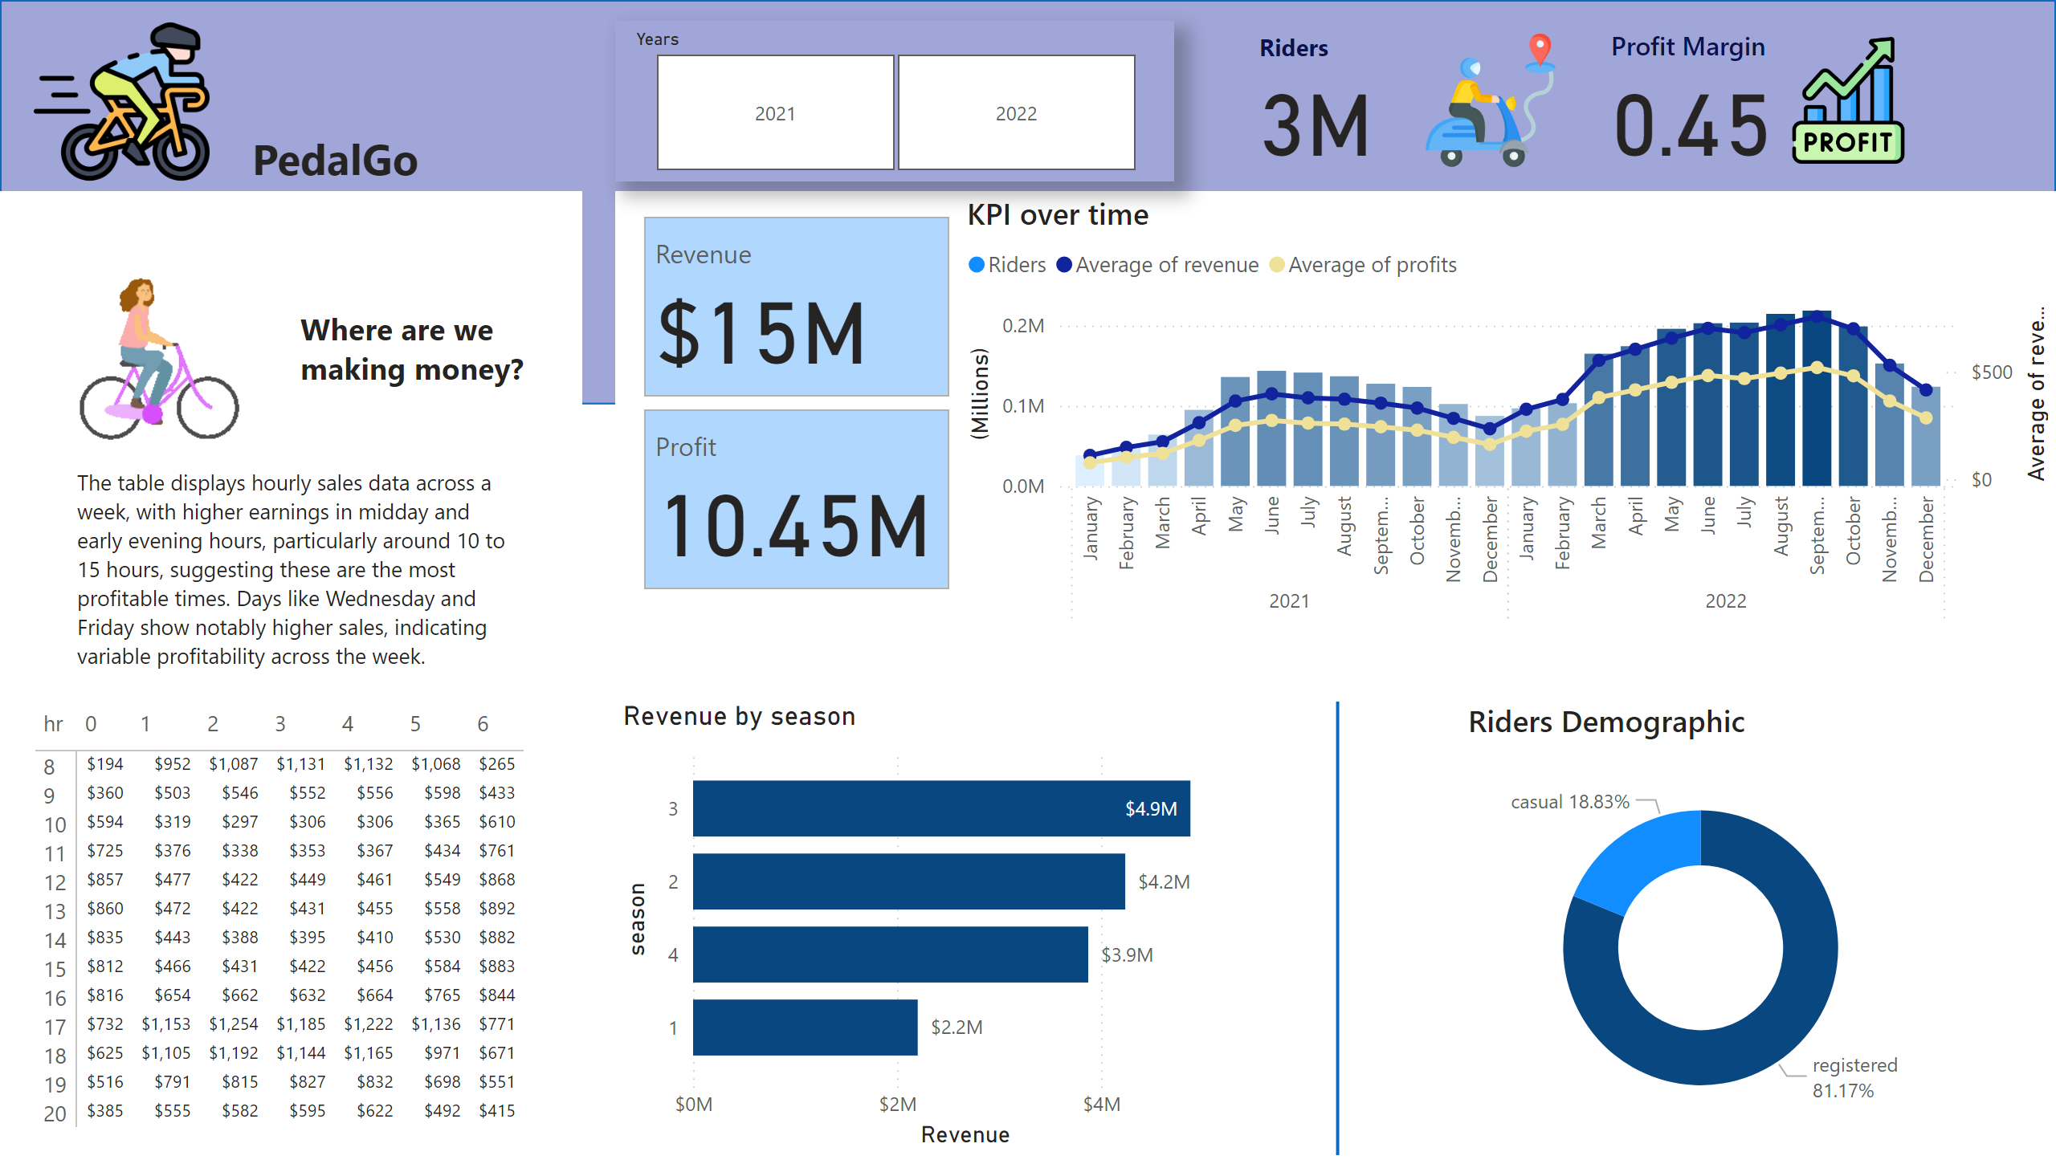
Page 1
Notes:
cardVisual
No alt text provided
cardVisual
No alt text provided
pivotTable
No alt text provided
textbox
No alt text provided
textbox
No alt text provided
KPI over time
No alt text provided
clusteredBarChart
No alt text provided
Riders Demographic
No alt text provided
shape
No alt text provided
cardVisual
No alt text provided
shape
No alt text provided
cardVisual
No alt text provided
image
No alt text provided
slicer
No alt text provided
textbox
No alt text provided
columnChart
No alt text provided
cardVisual
No alt text provided
KPI over time
No alt text provided

Slide 3

Page 2
Notes:
pivotTable
No alt text provided

